Slide 1


INVENTORY MANAGEMENT SYSTEM
K.RAMAKRISHNAN COLLEGE OF TECHNOLOGY
SABARINATH R (2403811720521047)
SAKTHI DARSHAN K (2403811720521049)
SUDHAN A (2403811720521053)
SURIYAA R (2403811720521054)
GUIDED BY
A.MALARMANNAN M.E

Slide 2
Problem Definition
Many organizations struggle to track stock, suppliers, and sales efficiently.
Poorly structured databases lead to data redundancy and inconsistency.
Manual or unorganized systems cause delays in retrieving information.
Difficulty in generating reports and monitoring inventory levels.
Need for a structured database system to ensure accuracy and efficiency.

Slide 3
Objectives of the Project
Design a structured database for inventory management.
Maintain accurate records of products, suppliers, and transactions.
Reduce data redundancy and improve consistency.
Enable fast and efficient data retrieval using queries.
Provide reliable reports for decision-making.

Slide 4
System Requirements
Hardware
Computer with minimum 4GB RAM
Storage: 500GB HDD/SSD
Software
DBMS: MySQL / Oracle / SQL Server
Frontend: Java / Python / Web Interface (if used)
Operating System: Windows / Linux

Slide 5
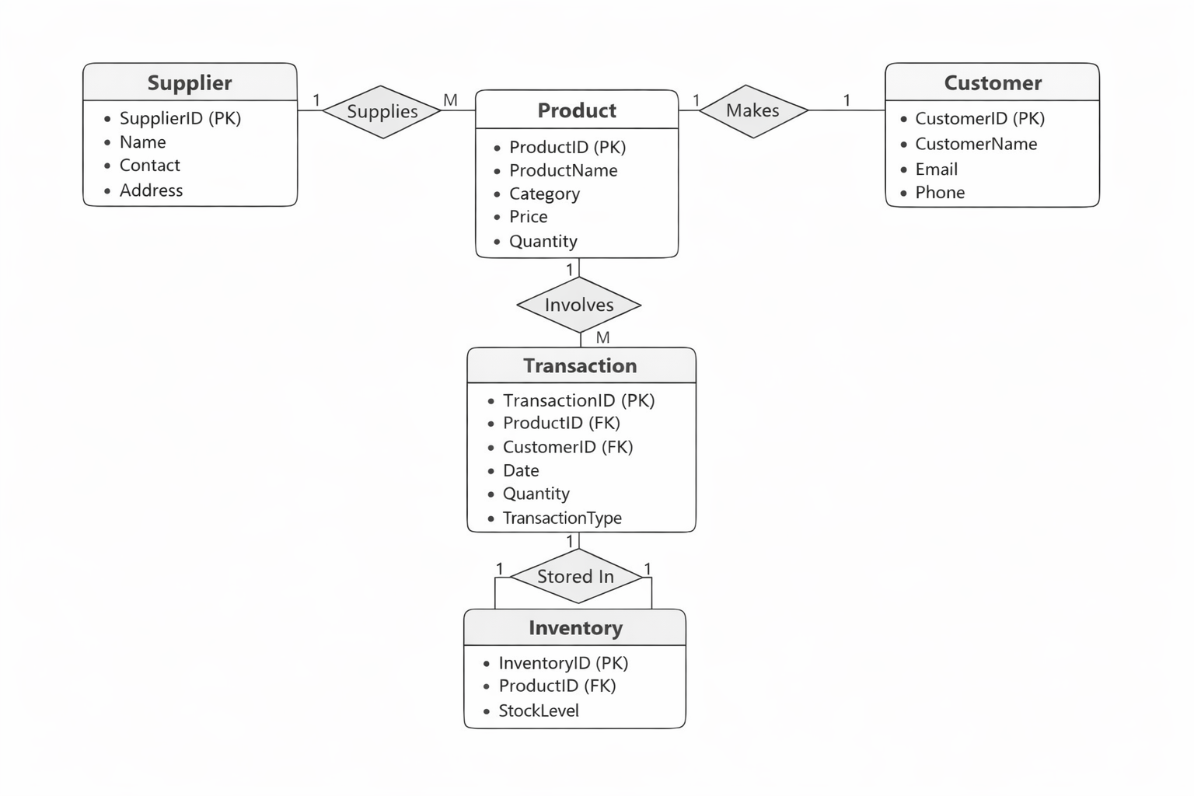
ER Diagram

Slide 6
Relational Schema
Product (ProductID, Name, Category, Price, Quantity)
Supplier (SupplierID, Name, Contact, Address)
Transaction (TransactionID, ProductID, Date, Quantity, Type)
Inventory (InventoryID, ProductID, StockLevel)
Customer (CustomerID,CustomerName,Email,Phone)

Slide 7
Normalization
1NF: Removed repeating groups and ensured atomic values.
2NF: Eliminated partial dependency by separating related tables.
3NF: Removed transitive dependency and ensured non-key attributes depend only on primary key.
Result: Reduced redundancy and improved data integrity.

Slide 8
SQL Implementation & Queries
CREATE TABLE statements for all entities.
INSERT queries for sample data.
SELECT queries for retrieving product and stock details.
UPDATE queries for modifying records.
DELETE queries for removing data.
JOIN queries to combine product, supplier, and transaction information.

Slide 9
Conclusion
Database system improves inventory tracking accuracy.
Reduces manual effort and data duplication.
Enables quick report generation and analysis.
Provides scalable and efficient inventory management.
Suitable for small, medium, and large organizations.

